Slide 1

MAJOR PRESENTATION
Gautam Buddha University
Submitted By: Mohammed Hamza(17/ICS/052)
Piyush Saini(17/ICS/061)
Prashant Gaurav(17/ICS/064)
Prayas Gautam(17/ICS/065)
Under Supervision of: Dr. Neeta Singh
Department of CSE
Assistant Professor
Gautam Buddha University

Slide 2
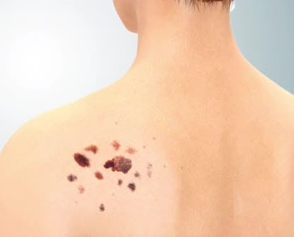
Skin cancer Classification
Using Convolutional Neural Networks
Notes:
NOTE:
To change the image on this slide, select the picture and delete it. Then click the Pictures icon in the placeholder to insert your own image.

Slide 3
Table Of Contents
Background of the Problem
Scope and Goal
Challenges
State-of-the-art
Hierarchy
Deep Learning
Supervised Learning
Convolutional Neural Networks
Methodology
Framework
HAM10000 Dataset
Model Training
Results
Conclusion

Slide 4
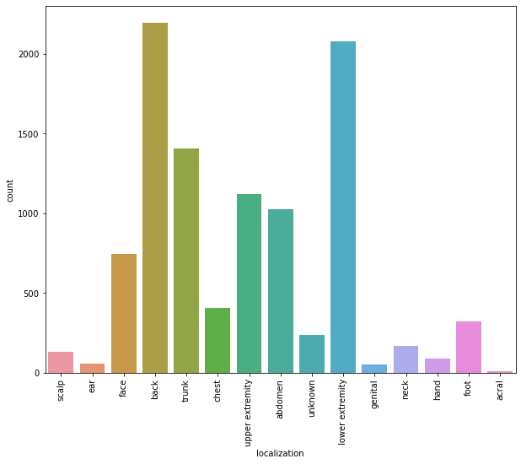
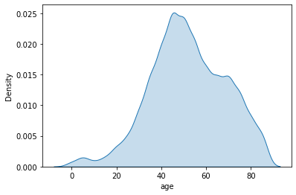
Background of the problem
Skin cancer: most predominant type of cancer
The frequency of melanoma doubles every 20 years
Melanoma is a deadly form of skin cancer, but survival rates are high if detected and diagnosed early.
Without computer-based assistance: 60~80% detection accuracy

Slide 5
Scope and Goal
Scope:
Assist physicians in classifying skin lesions (especially in
melanoma detection: 2-class classifier problem)
Goal:
Use state-of-the-art techniques, called Deep Learning, to design an intelligent medical imaging-based skin lesion diagnosis system
Achieve (or improve upon) state-of-the-art results for:
skin lesion segmentation, and
skin lesion classification
Evaluate the impact of skin lesion segmentation on the accuracy of the classifier

Slide 6
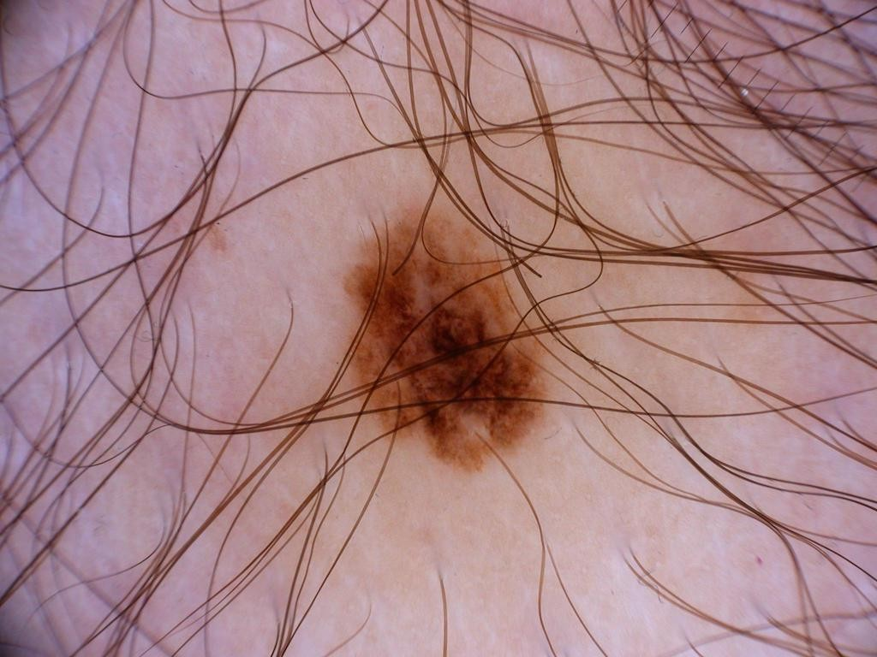
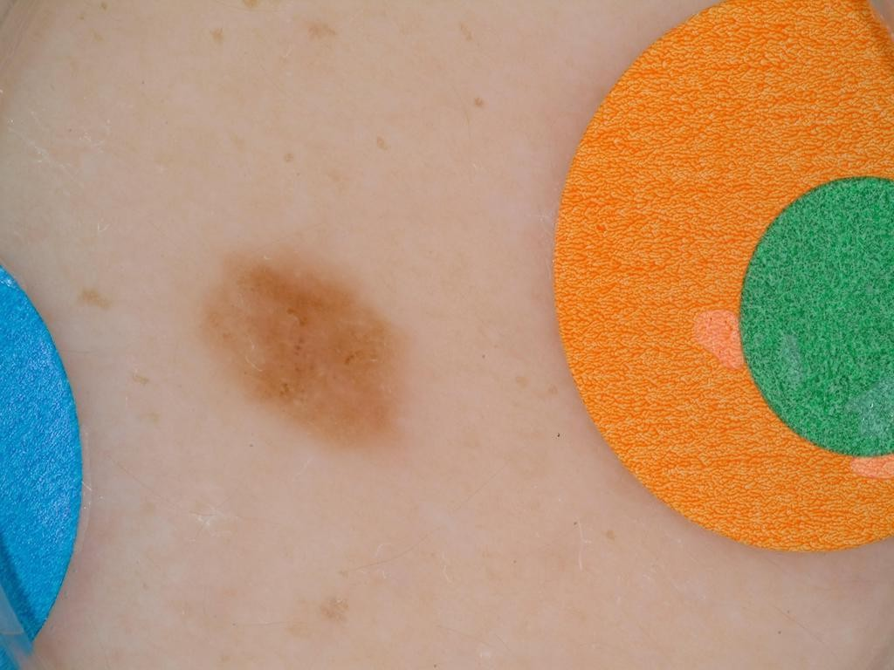
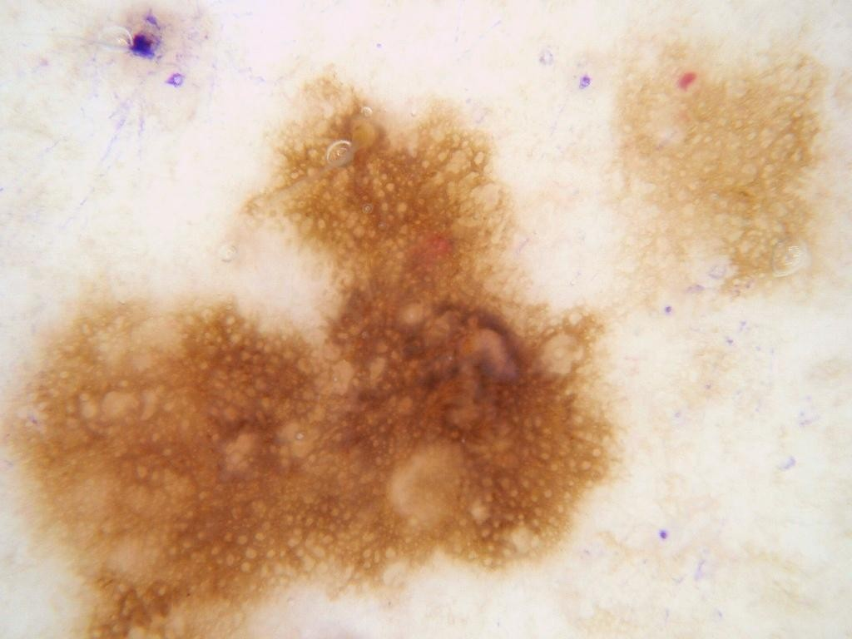
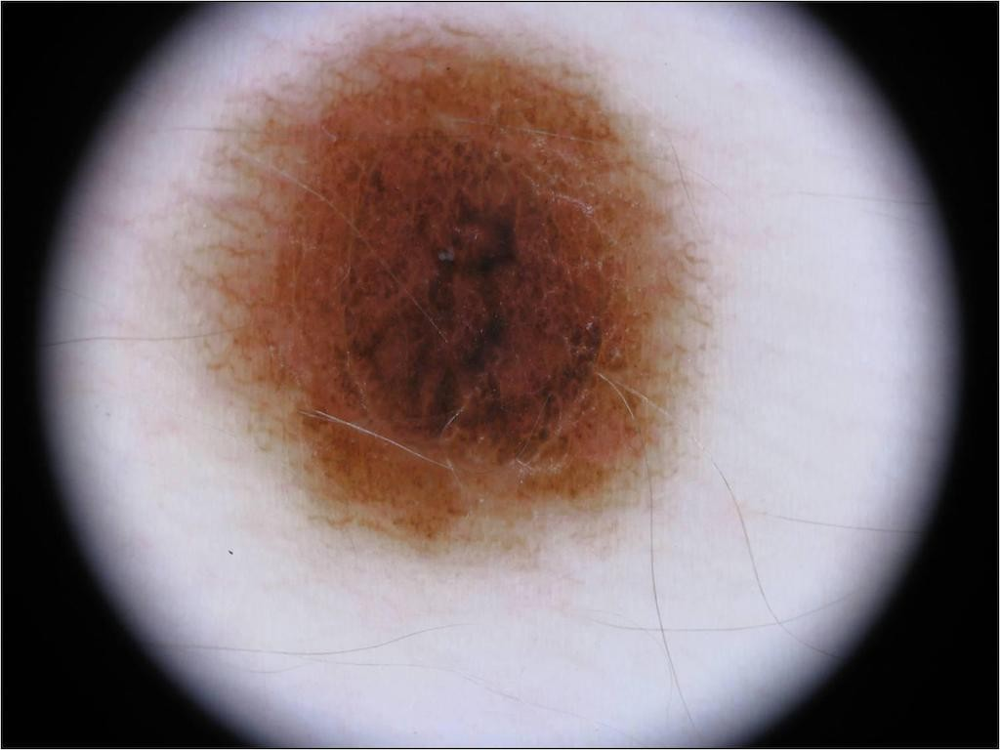
Challenges
Dermoscopic images may:
Contain artifacts, such as: moles, freckles, hair, patches, shading and noise.
Present low contrast images between lesion and background
Contain multiple skin lesions

Slide 7
State-of-the-art

Slide 8
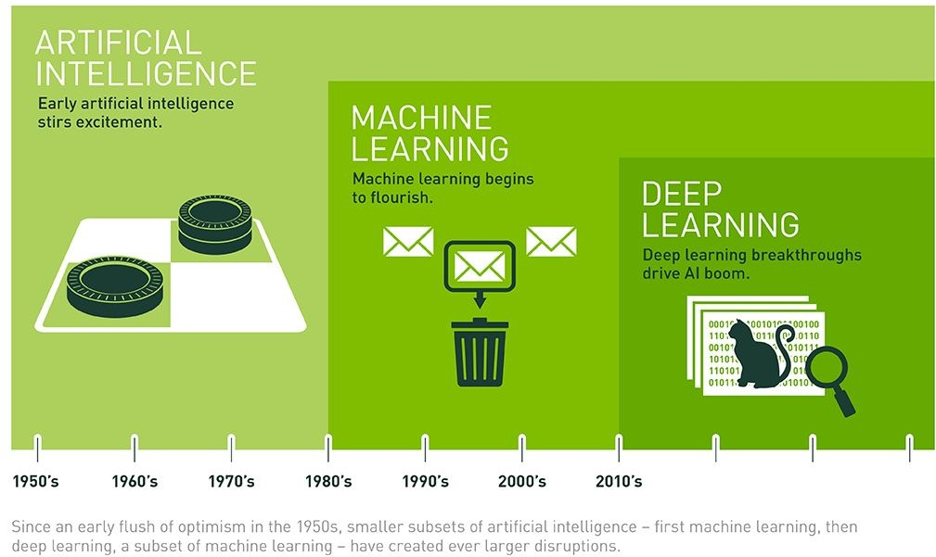
State-of-the-art hierarchy

Slide 9
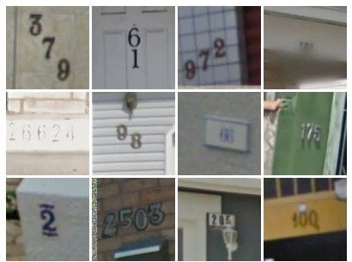
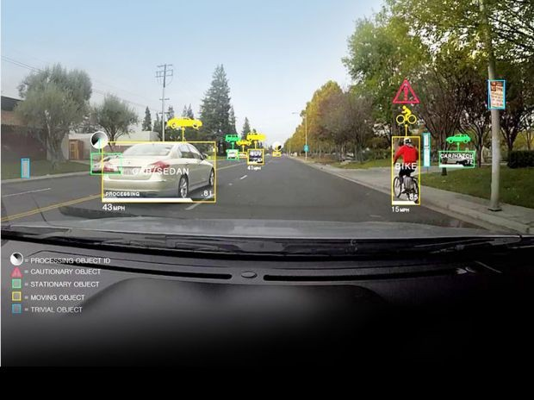
Deep learning motivation
Deep learning is a type of machine learning and artificial intelligence (AI) that imitates the way humans gain certain types of knowledge.
Image representations to:
Image classification
Object detection and recognition
Semantic Segmentation
[Goodfellow et al. 2014]
Self-driving cars

Slide 10
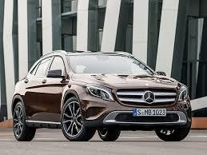
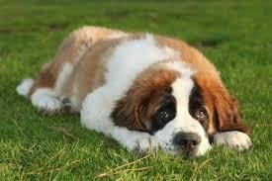
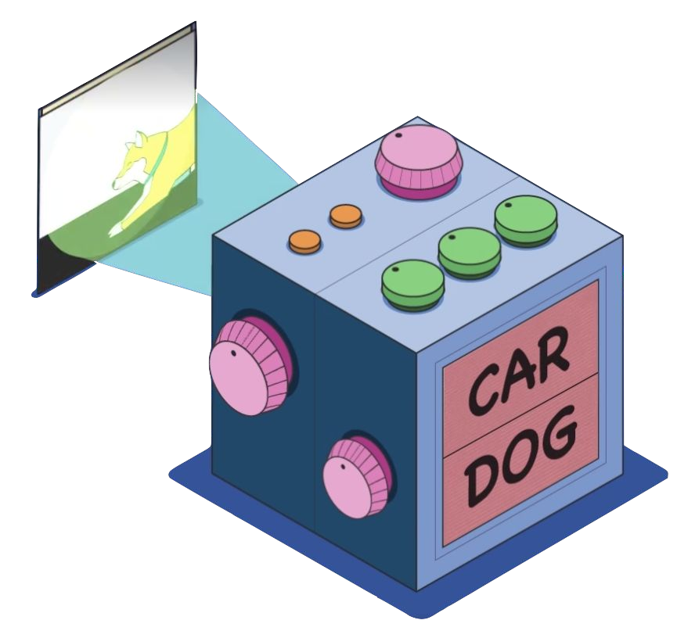
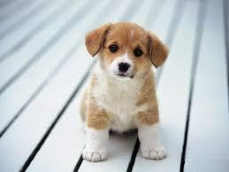
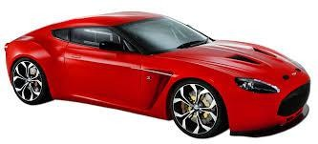
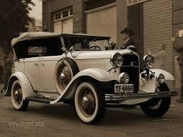
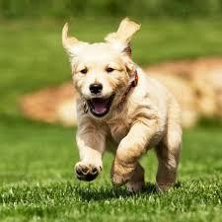
Supervised Learning
Parameters
[Car]
[Dog]

Slide 11
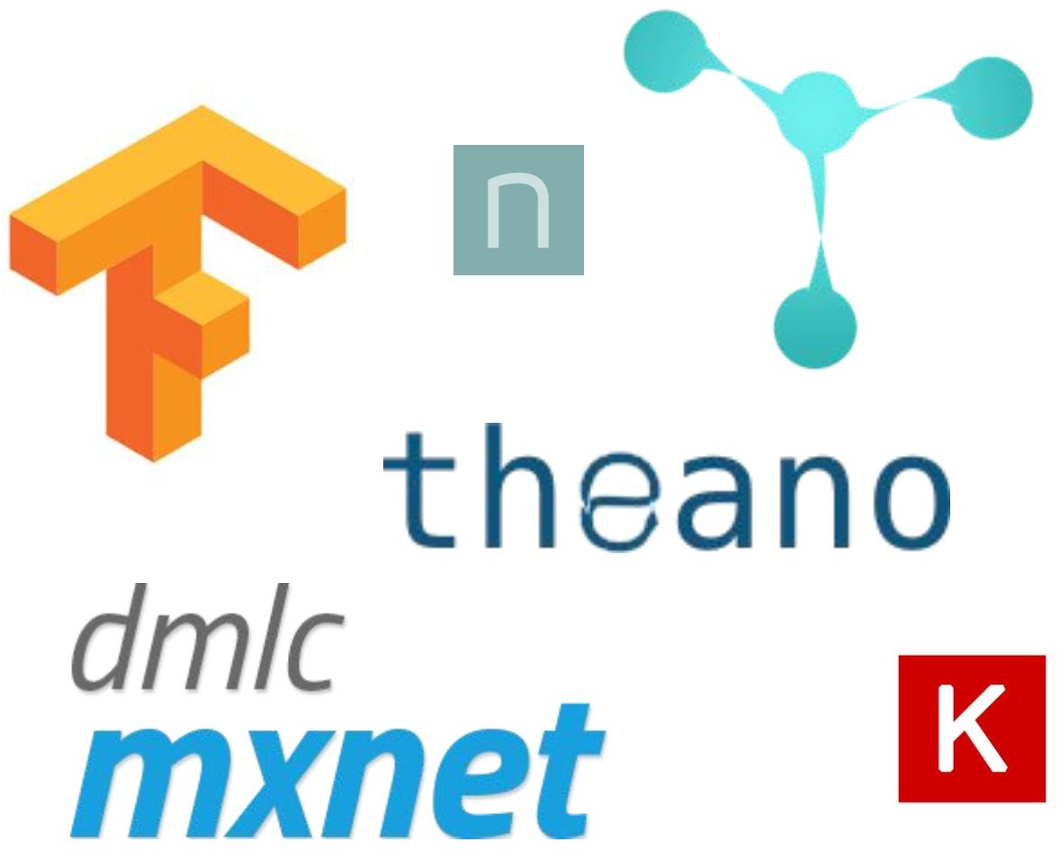
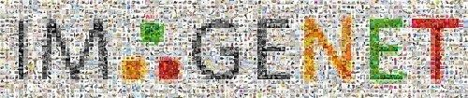

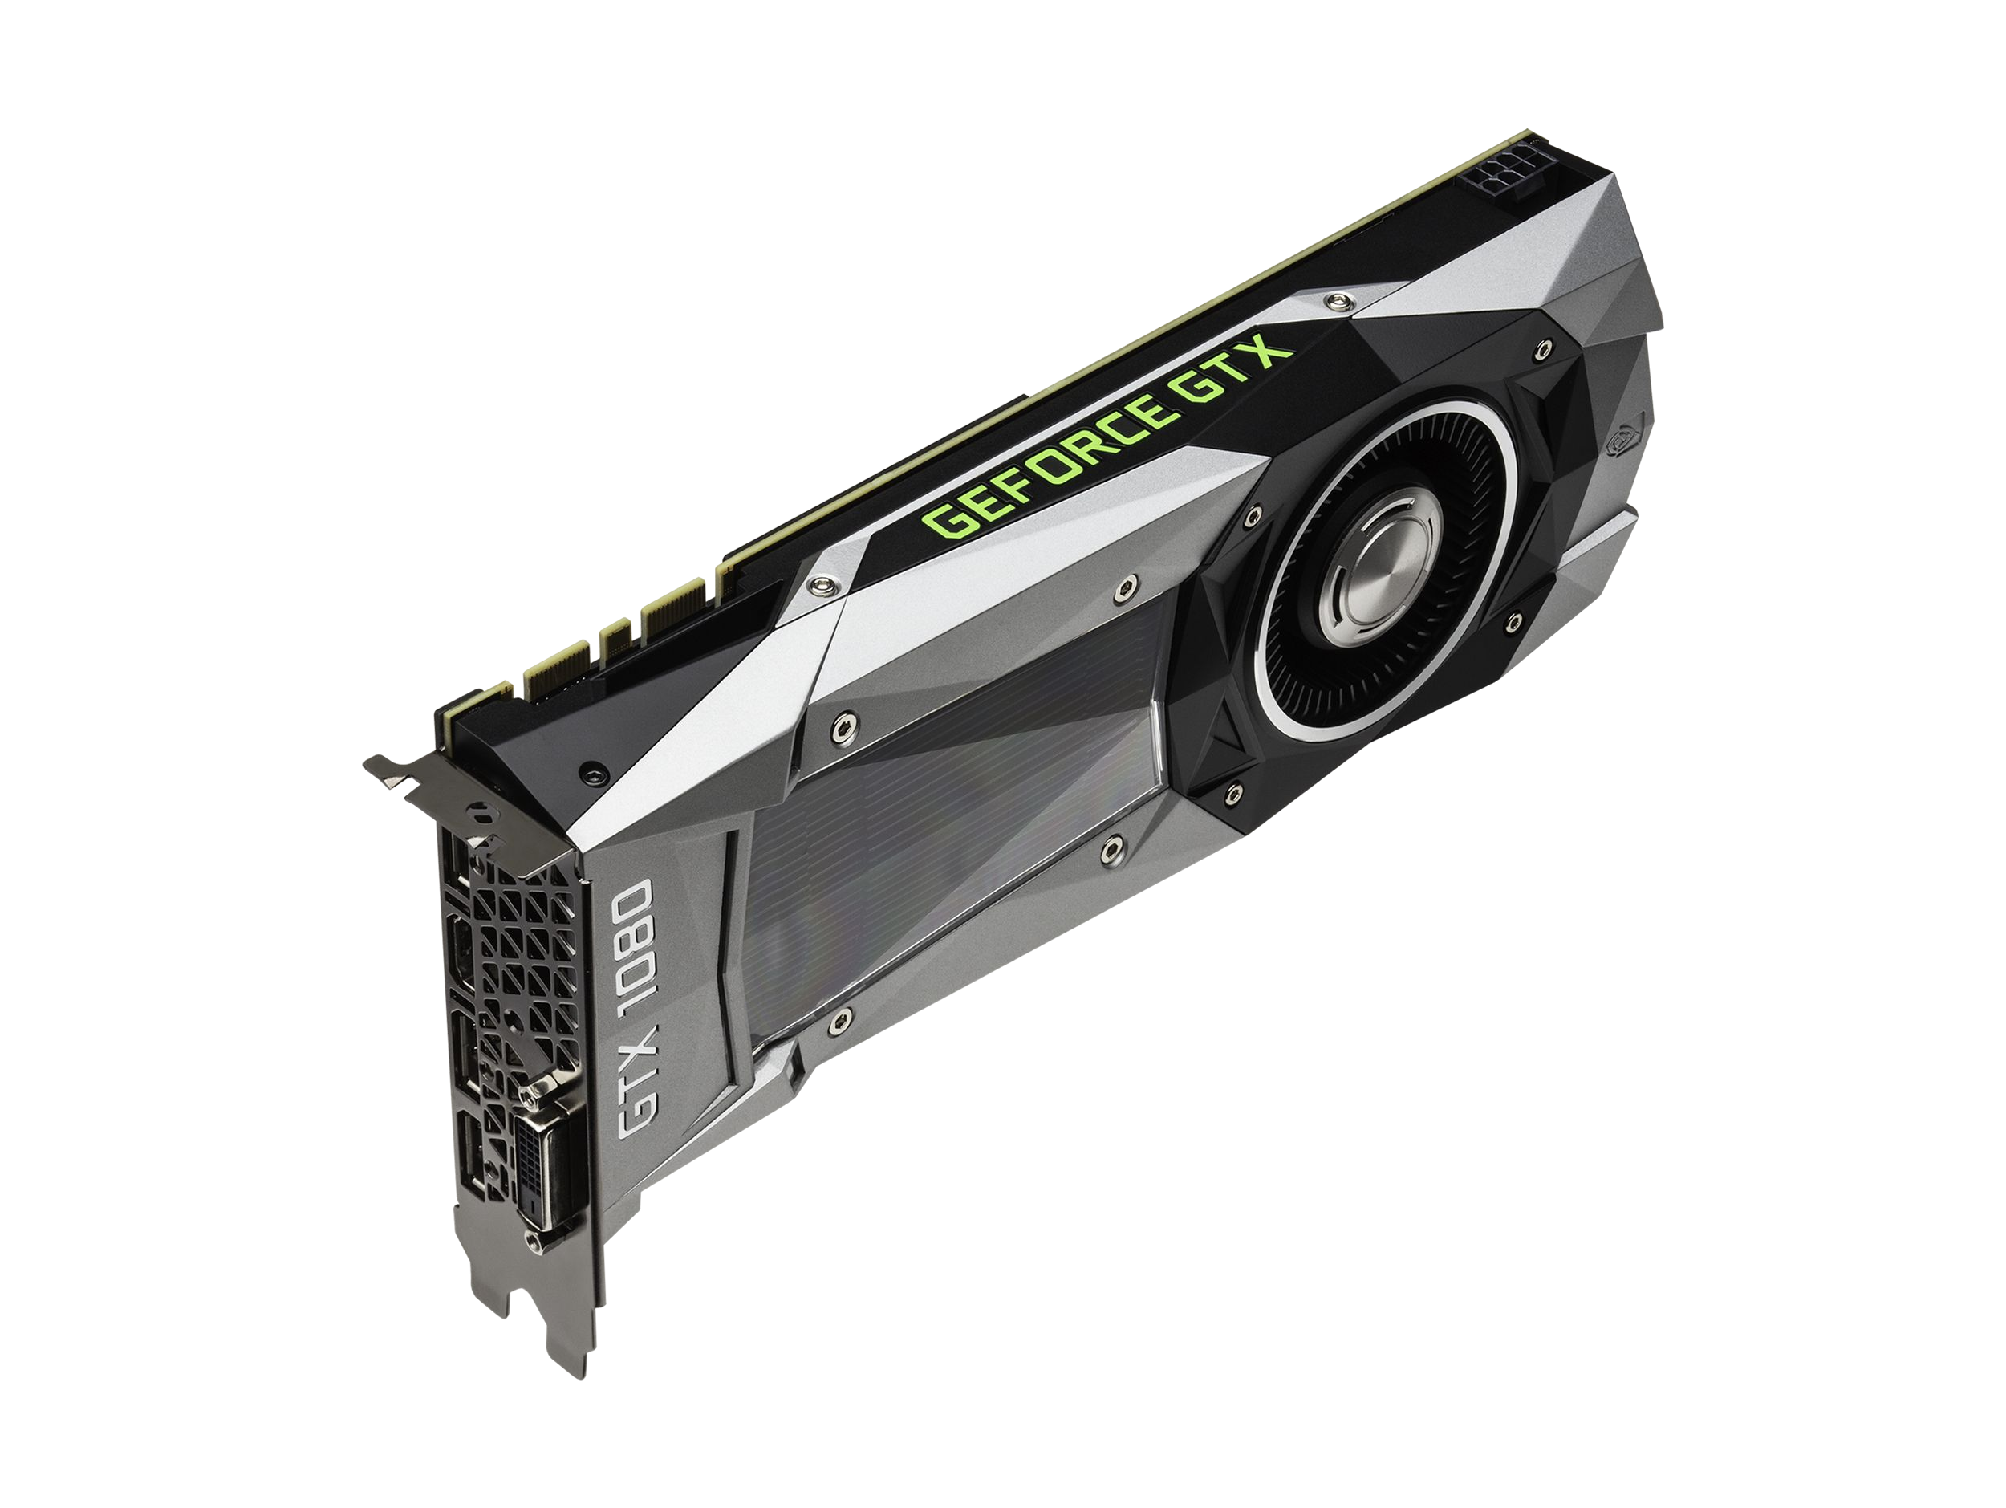

Why Deep Learning now
Framework
Large datasets
GPUs (Graphics Processing Unit)
* Not applicable to medical imaging
[NVIDIA ]

Slide 12
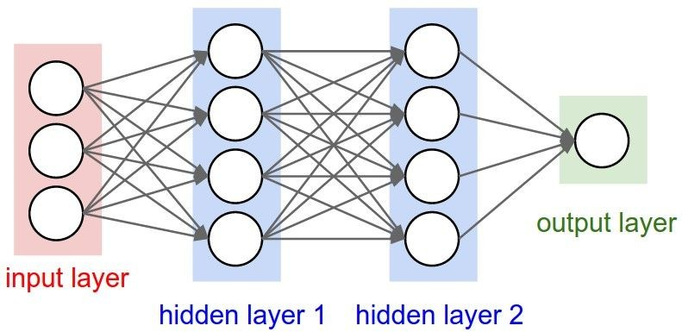
Convolutional Neural Networks
Also known as ConvNets or CNNs
Some input vector (our images).
Our class label
Convolutional Layers
Activation Layers
Pooling Layers

Slide 13

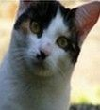
ConvNets for classification
Classification → Scoring:
The CNN computes a class score {float} to each image
This score will be related to a class label {integer}
f
Class scores, indicating class labels
training
[224x224x3]

Slide 14
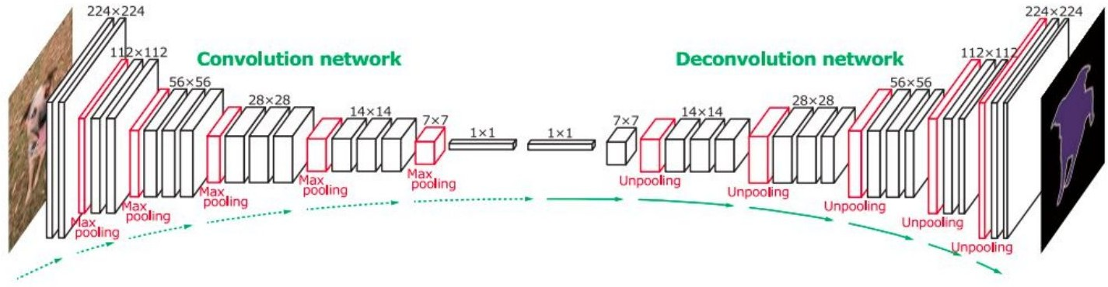
ConvNets for segmentation
Upsampling
From labels {1x1} to Segmented Image {224x224} px
Slide credit: CS231n
14

Slide 15
Methodology

Slide 16



Framework
Python environment:
Keras - Deep Learning Library for Theano or TensorFlow
OpenCV / PIL (Python Imaging Library)
SciPy (Library for Mathematics, Science and Engineering)
Scikit-learn (Machine Learning Library)
CUDA library for the GPUs

Slide 17
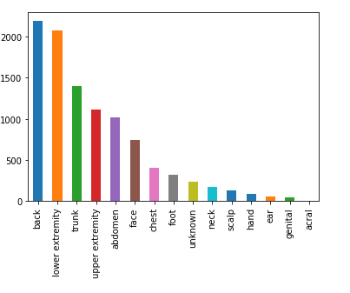
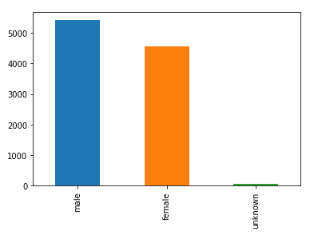
HAM10000 Dataset
HAM10000 Dataset contains a total 10k+ dermoscopic images:
Melanocytic nevi
Melanoma
Benign keratosis-like lesions
Basal cell carcinoma
Actinic keratoses
Vascular lesions
Dermatofibroma

Slide 18
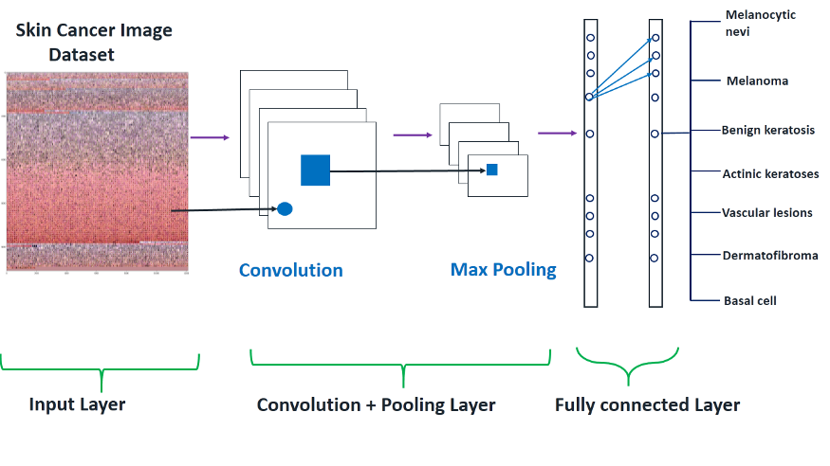
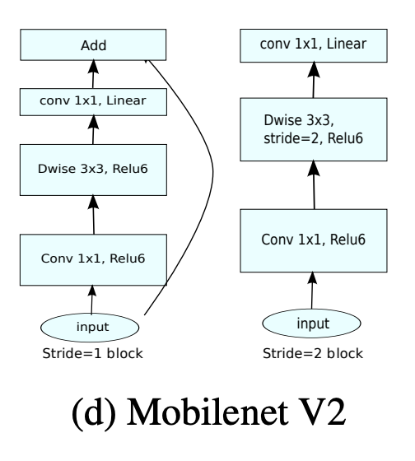
Model Training
CNN Architecture used:
MobileNetV2 is used to train the Model

Slide 19
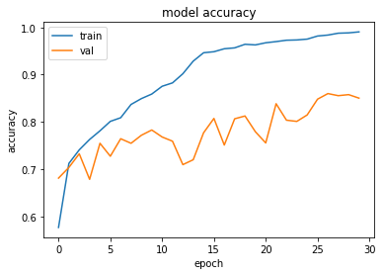
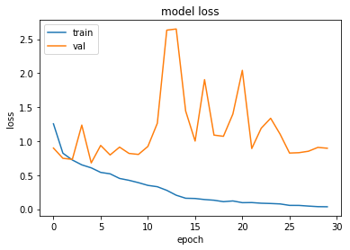
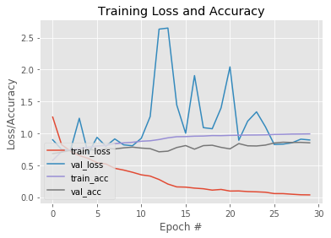
Training Graphs
Test Accuracy: 82.32530827950674

Slide 20
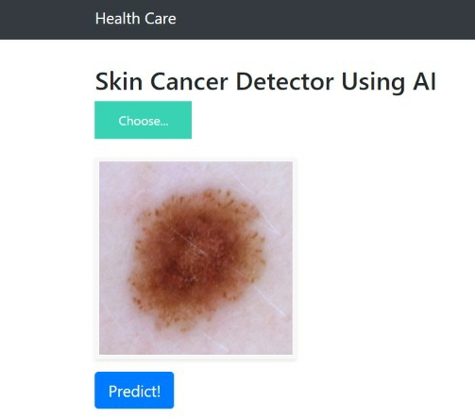
Results

Slide 21
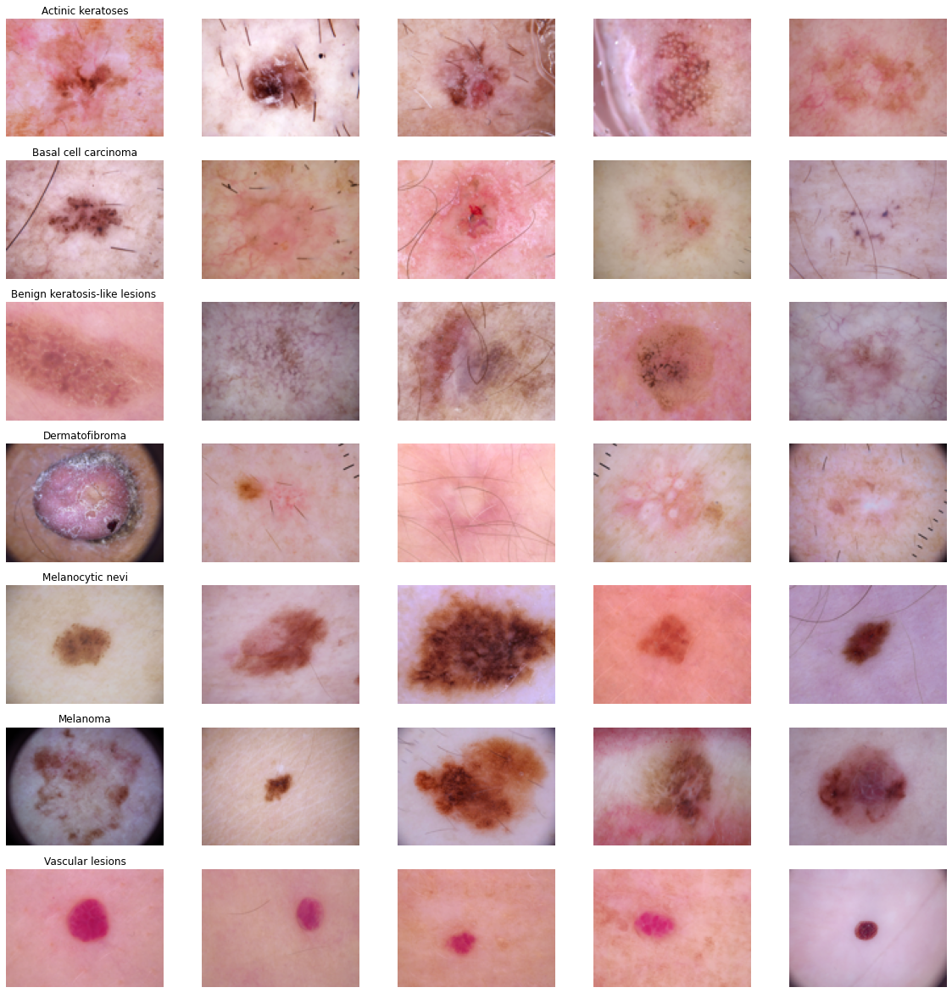
Classification Images
These are the 7 types of skin
lesions present in the Dataset.
Out of these 7 types we can detect the type of Skin Cancer present in the Body.

Slide 22
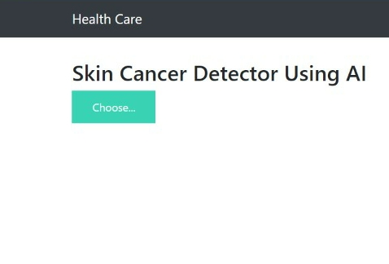
Result: Input
Here we can input the lesion image to predict the type of cancer present in the body.

Slide 23
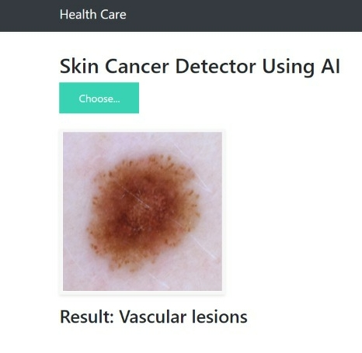
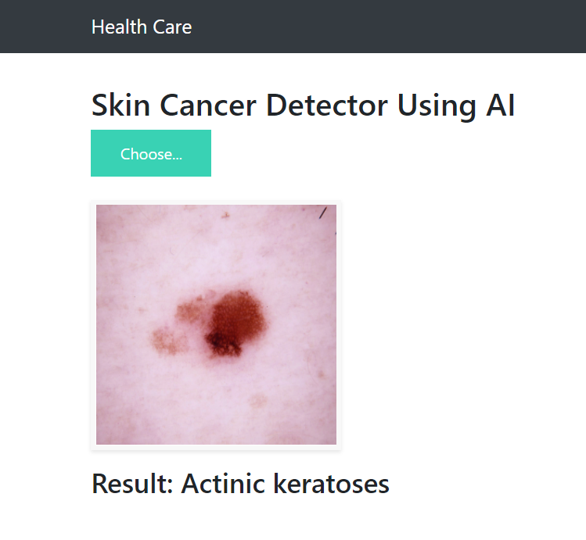
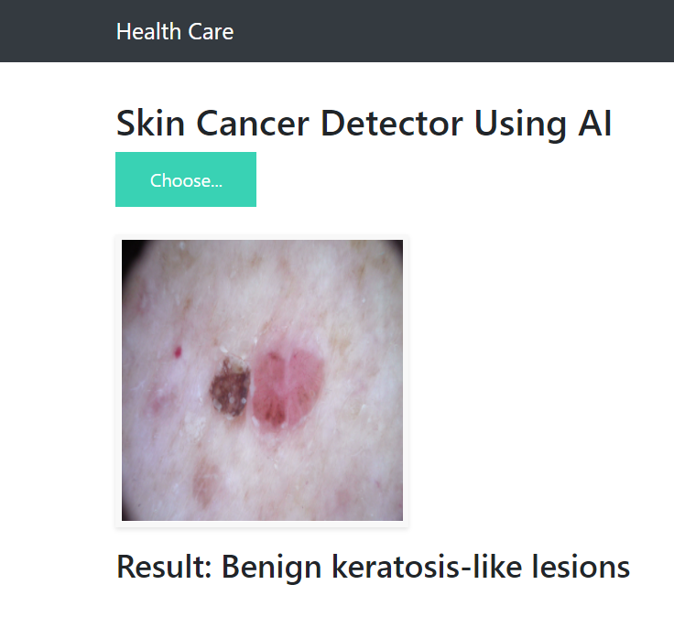
Result: Output

Slide 24
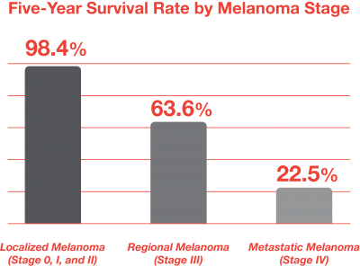
Conclusion
With the given model we can classify the 7 types skin lesion present in the dataset.
As the rate of skin cancers among youth is also increasing we can identify it in early stages, it can be cured.

Slide 25


